Slide 1
Internet model and architecture

Slide 2
Multi-layer Network Models
Computer devices—from laptops to servers—must communicate smoothly despite being built by different companies.
Early networking was fragmented: each vendor used its own communication rules, causing incompatibility.
To enable uniform, interoperable communication, the world needed standard frameworks that describe how data should travel from one device to another.
These frameworks organize communication into layers, where each layer handles a specific function (e.g., routing, addressing, error checking, applications).
Copyright 2005 John Wiley & Sons, Inc
1 - <number>

Slide 3
Multi-layer Network Models
This need for structure and compatibility led to the development of the two most important formal network models: OSI and Internet
Open Systems Interconnection Model
  Created by International Standards Organization (ISO) as a framework for computer network standards in 1984
  Based on 7 layers
Internet Model
  Created by DARPA originally in early 70’s
  Developed to solve to the problem of internetworking
  Based on 5 layers
  Based on Transmission Control Protocol/ Internet Protocol (TCP/IP) suite
Copyright 2005 John Wiley & Sons, Inc
1 - <number>

Slide 4
7-Layer Model of OSI
Application Layer
  set of utilities used by application programs
Presentation Layer
  formats data for presentation to the user
  provides data interfaces, data compression and translation between different data formats
Session Layer
  initiates, maintains and terminates each logical session between sender and receiver
Physical DataLink Network Transport Session Presentation Application
Please Do Not Touch Steve’s Pet Alligator
Copyright 2005 John Wiley & Sons, Inc
1 - <number>

Slide 5
7-Layer Model of OSI
Transport Layer
  deals with end-to-end issues such as segmenting the message for network transport, and maintaining the logical connections between sender and receiver
Network Layer
  responsible for making routing decisions
Data Link Layer
  deals with message delineation, error control and network medium access control
Physical Layer
  defines how individual bits are formatted to be transmitted through the network
Copyright 2005 John Wiley & Sons, Inc
1 - <number>

Slide 6
Internet’s 5-Layer Model
Application Layer
  used by application program
Transport Layer
  responsible for establishing end-to-end connections, translates domain names into numeric addresses and segments messages
Network Layer - same as in OSI model
Data Link Layer - same as in OSI model
Physical Layer - same as in OSI model
Physical DataLink Network Transport Application
Please Do Not Touch Alligator
*
Copyright 2005 John Wiley & Sons, Inc
1 - <number>

Slide 7
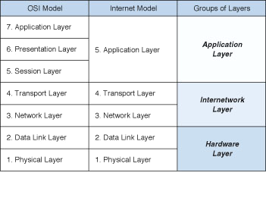
Comparison of Network Models
Copyright 2005 John Wiley & Sons, Inc
1 - <number>

Slide 8
Message Transmission Using Layers
sender
receiver
Applications
Applications
A receiving layer wraps incoming message with an envelope
  Adds layer related addressing information
A receiving layer removes the layer related envelope and forwards the message up
Copyright 2005 John Wiley & Sons, Inc
1 - <number>

Slide 9
Protocols
Used by Network model layers
Sets of rules to define how to communicate at each layer and how to interface with adjacent layers
Layer N+1
Layer N+1
Layer N
Layer N
Layer N-1
Layer N-1
sender
receiver
Copyright 2005 John Wiley & Sons, Inc
1 - <number>

Slide 10
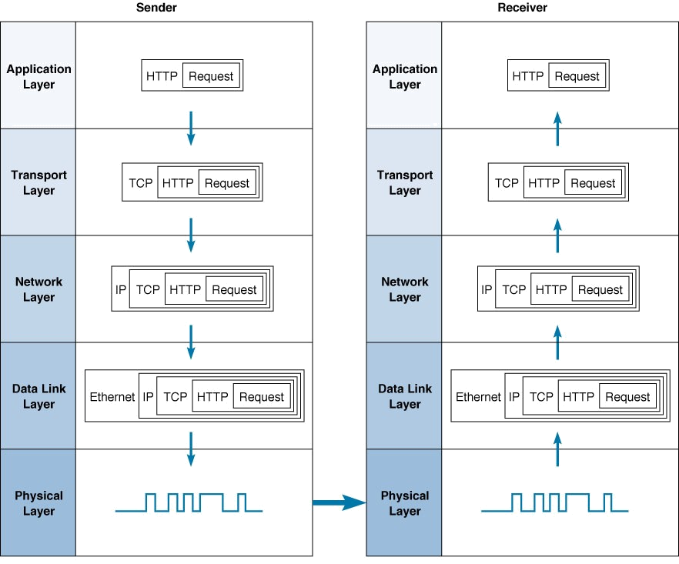
Message Transmission Example
Copyright 2005 John Wiley & Sons, Inc
1 - <number>

Slide 11
Important Points to Observe
Many different software packages (protocols) and many different packets (at different layers)
  Easy to develop new software
  Simple to change the software at any level
Matching layers communicate at different computers
  Accomplished by standards
  e.g., Physical layer at the sending computer must be the same in the receiving computer
Somewhat inefficient
  Involves many software and packets
  Packet overhead (slower transmission, processing time)
Copyright 2005 John Wiley & Sons, Inc
1 - <number>

Slide 12
Standards
Importance
  Provide a “fixed” way for hardware and/or software systems (different companies) to communicate
  Help promote competition and decrease the price
Types of Standards
  Formal standards
    Developed by an industry or government standards-making body
  De-facto standards
    Emerge in the marketplace and widely used
    Lack official backing by a standards-making body
Copyright 2005 John Wiley & Sons, Inc
1 - <number>

Slide 13
Standardization Processes
Specification
  Developing the nomenclature and identifying the problems to be addressed
Identification of choices
  Identifying solutions to the problems and choose the “optimum” solution
Acceptance
  Defining the solution, getting it recognized by industry so that a uniform solution is accepted
Copyright 2005 John Wiley & Sons, Inc
1 - <number>

Slide 14
Major Standards Bodies
ISO (International Organization for Standardization)
  Technical recommendations for data communication interfaces
  Composed of each country’s national standards orgs.
  Based in Geneva, Switzerland (www.iso.ch)
ITU-T (International Telecommunications Union –Telecom Group
  Technical recommendations about telephone, telegraph and data communications interfaces
  Composed of representatives from each country in UN
  Based in Geneva, Switzerland (www.itu.int)
Copyright 2005 John Wiley & Sons, Inc
1 - <number>

Slide 15
Major Standards Bodies (Cont.)
ANSI (American National Standards Institute)
  Coordinating organization for US (not a standards- making body)
  www.ansi.org
IEEE (Institute of Electrical and Electronic Engineers)
  Professional society; also develops mostly LAN standards
  standards.ieee.org
IETF (Internet Engineering Task Force)
  Develops Internet standards
  No official membership (anyone welcomes)
  www.ietf.org
Copyright 2005 John Wiley & Sons, Inc
1 - <number>

Slide 16
Some Data Comm. Standards
Layer
Common Standards
5. Application layer
HTTP, HTML (Web)
MPEG, H.323 (audio/video)
IMAP, POP (e-mail)
4. Transport layer
TCP (Internet)
SPX (Novell LANs)
3. Network layer
IP (Internet)
IPX (Novell LANs)
2. Data link layer
Ethernet (LAN)
Frame Relay (WAN)
PPP (dial-up via modem for MAN)
1. Physical layer
RS-232c cable (LAN)
Category 5 twisted pair (LAN)
V.92 (56 kbps modem)
Copyright 2005 John Wiley & Sons, Inc
1 - <number>

Slide 17
Emerging Trends in Networking
Pervasive Networking
Integration of Voice, Video and Data
New Information Services
Copyright 2005 John Wiley & Sons, Inc
1 - <number>

Slide 18
Pervasive Networking
Means “Network access everywhere”
Exponential growth of Network use
Many new types of devices will have network capability
Exponential growth of data rates for all kinds of networking
Broadband communications
  Use circuits with 1 Mbps or higher (e.g., DSL)
Copyright 2005 John Wiley & Sons, Inc
1 - <number>

Slide 19
Integration of Voice, Video & Data
Also called “Convergence”
  Networks that were previously transmitted using separate networks will merge into a single, high speed, multimedia network in the near future
First step (already underway)
  Integration of voice and data
Next Step
  Video merging with voice and data
  Will take longer partly due to the high data rates required for video
Copyright 2005 John Wiley & Sons, Inc
1 - <number>

Slide 20
New Information Services
World Wide Web based
  Many new types of information services becoming available
    Services that help ensure quality of information received over www
Application Service Providers (ASPs)
  Develop specific systems for companies
    Providing and operating a payroll system for a company that does not have one of its own
Information Utilities (Future of ASPs)
  Providing a wide range of info services (email, web, payroll, etc.) (similar to electric or water utilities)
Copyright 2005 John Wiley & Sons, Inc
1 - <number>

Slide 21
Application Layer - Introduction
Applications
(e.g., email, web,
word processing)
Application Layer
Transport Layer
Network Layer
Functions of Applications
  Data storage
    Storing of data generated by programs (e.g., files, records)
  Data access logic
    Processing required to access stored data (e.g., SQL)
  Application logic
    Business logic
  Presentation logic
    Presentation of info to user and acceptance of user commands
Copyright 2005 John Wiley & Sons, Inc
1 - <number>

Slide 22
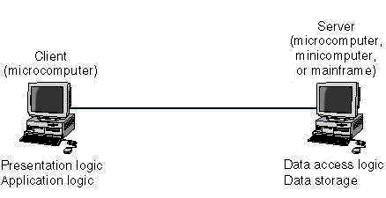
Client-Server Architectures
Used by most networks today
Server
(PC, mini, mainframe)
Client
(PC)
Example: Using a Web browser to get pages from
Presentation logic
Application logic
Data Access logic
Data Storage
Application logic
may reside on the client, server or be split up between the two
Copyright 2005 John Wiley & Sons, Inc
1 - <number>

Slide 23
Client-Server Architectures
Advantages
  More efficient because of distributed processing
  Allow hardware and software from different vendors to be used together
Disadvantages
  Difficulty in getting software from different vendors to work together smoothly
  ➔May require Middleware, a third category of software
Copyright 2005 John Wiley & Sons, Inc
1 - <number>

Slide 24
Middleware
client application programs
a standard way of translating between software from different vendors
Manages message transfers
Insulates network changes from the clients ((e.g., adding a new server)
Middleware
server application programs
Examples:
  Distributed Computing Environment (DCE)
  Common Object Request Broker Architecture (CORBA)
  Open Database Connectivity (ODBC)
Copyright 2005 John Wiley & Sons, Inc
1 - <number>

Slide 25
Multi-tier Architectures
Involve more than two computers in distributing application program logic
  2-tier architecture (architectures discussed so far)
  3-tier architecture
    3 sets of computers involved
  N-tier architecture
    more than three sets of computers used
Copyright 2005 John Wiley & Sons, Inc
1 - <number>

Slide 26
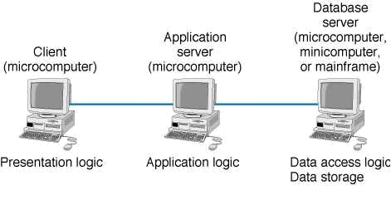
3-tier Architecture
Copyright 2005 John Wiley & Sons, Inc
1 - <number>

Slide 27
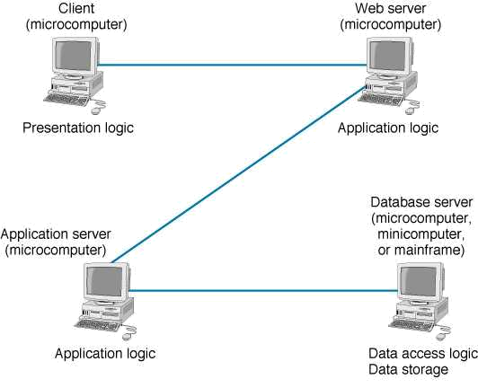
N-tier Architecture
Copyright 2005 John Wiley & Sons, Inc
1 - <number>

Slide 28
Multi-tier Architectures
Advantages
  Better load balancing:
    More evenly distributed processing. (e.g., application logic distributed between several servers.)
  More scalable:
    Only servers experiencing high demand need be upgraded
Disadvantages
  Heavily loaded network:
    More distributed processing → more exchanges
  Difficult to program and test due to increased complexity
Copyright 2005 John Wiley & Sons, Inc
1 - <number>

Slide 29
Fat vs. Thin Clients
Depends on how much of the application logic resides on the client
  Fat client: (a.k.a., thick client)
    All or most of the application logic
  Thin client:
    Little or no application logic
    Becoming popular because easier to manage, (only the server application logic generally needs to be updated)
    The best example: World Wide Web architecture (uses a two-tier, thin client architecture)
Copyright 2005 John Wiley & Sons, Inc
1 - <number>

Slide 30
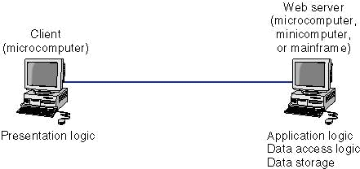
Thin-Client Example: Web Architecture
Client
(PC)
Web Server
(PC, mini, mainframe)
Presentation logic
Application Logic
Data Access logic
Data Storage
Copyright 2005 John Wiley & Sons, Inc
1 - <number>

Slide 31
Criteria for Choosing Architecture
Infrastructure Cost
  Cost of servers, clients, and circuits
  Mainframes: very expensive; terminals, PCs: very inexpensive
Development Cost
  Mainly cost of software development
  Software: expensive to develop; off-the-shelf software: inexpensive
Scalability
  Ability to increase (or decrease) in computing capacity as network demand changes
  Mainframes: not scalable; PCs: highly scalable
Copyright 2005 John Wiley & Sons, Inc
1 - <number>

Slide 32
Choosing an Architecture
Host-Based
Client-Based
Client-Server
Cost of Infrastructure
High
Medium
Low
Cost of Development
Low
Medium
High
Scalability
Low
Medium
High
Copyright 2005 John Wiley & Sons, Inc
1 - <number>

Slide 33
Applications
World Wide Web
E-mail
File Transfer
Videoconferencing
Instant Messaging
Copyright 2005 John Wiley & Sons, Inc
1 - <number>

Slide 34
World Wide Web
Two central ideas:
  Hypertext
    A document containing links to other documents
  Uniform Resource Locators (URLs)
    A formal way of identifying links to other documents
Invention of WWW (1989)
  By Tim Berners-Lee at CERN in Switzerland
First graphical browser, Mosaic, (1993)
  By Marc Andressen at NCSA in USA; later founded Netscape
CERN - Centre Européan pour Rechèrche Nucleaire
NCSA - National Center for Supercomputing Applications
Copyright 2005 John Wiley & Sons, Inc
1 - <number>

Slide 35
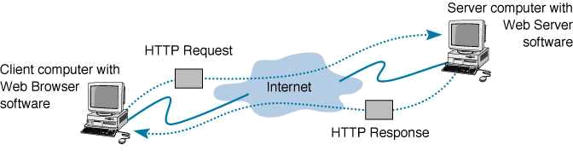
How the Web Works
Main Web communications protocol:
Server Computer
HTTP - Hypertext Transfer Protocol
HTTP Request
Client Computer
HTTP Response
A request-response cycle: include multiple steps since web pages often contain embedded files, such as graphics, each requiring a separate response.
Clicking on a hyperlink or typing a URL into a browser starts a request-response cycle
Copyright 2005 John Wiley & Sons, Inc
1 - <number>

Slide 36
HTTP Request Message
Request line
(command, URL, HTTP version number)
required
(If the user types in the URL by themselves, then the referring page is blank.)
Request header
(information on the browser,
date, and the referring page )
optional
Request body
(information sent to the server,
e.g., from a form)
optional
Copyright 2005 John Wiley & Sons, Inc
1 - <number>

Slide 37
Example of an HTTP Request
Command URL HTTP version
GET http://www.kelley.indiana.edu/ardennis/home.htm HTTP/1.1
Date: Mon 06 Aug 2001 17:35:46 GMT
User-Agent: Mozilla/6.0
Referer: http://www.indiana.edu/~aisdept/faculty.htm
Request
Line
Request Header
URL that contained the link to the requested URL
Web browser (code name for Netscape)
Note that this HTTP Request message has no “Body” part.
GMT – Greenwich Mean Time
Copyright 2005 John Wiley & Sons, Inc
1 - <number>

Slide 38
HTTP Response Message
Response status
(http version number, status code, reason)
optional
Response header
(information on the server, date,
URL of the page retrieved, format used )
optional
Response body
(requested web page)
required
Copyright 2005 John Wiley & Sons, Inc
1 - <number>

Slide 39
Example of an HTTP Response
HTTP/1.1 200 OK
Response Status
Date: Mon 06 Aug 2001 17:35:46 GMT
Server: NCSA/1.3
Location: http:// www.kelley.indiana.edu/adennis/home.htm
Content-type: text/html
Response Header
<html>
<head>
<title>Allen R. Dennis</title>
</head>
<body>
<H2> Allen R. Dennis </H2>
<P>Welcome to the home page of Allen R. Dennis</P>
</body>
</html>
Response
Body
Another example of response status: HTTP/1.1 404 page not found)
Copyright 2005 John Wiley & Sons, Inc
1 - <number>

Slide 40
HTML - Hypertext Markup Language
A protocol used to format Web pages
Also developed at CERN (initially for text files)
TAGs embedded in HTML documents
  include information on how to format the file
Extensions to HTML needed to format multimedia files
XML - Extensible Markup Language
  A new markup language becoming popular
Copyright 2005 John Wiley & Sons, Inc
1 - <number>

Slide 41
Electronic Mail
Heavily used Internet application
  Much, much faster than snail mail (regular mail)
  Extremely inexpensive (compared to $3-$10 per paper mail cost)
    Includes preparation, paper, postage, etc,
  Can substitute for other forms of communication, such as telephone calls
    Eliminates “telephone tag”
      E-mail users can answer at his/her convenience, instead of time of call
Copyright 2005 John Wiley & Sons, Inc
1 - <number>

Slide 42
E-mail Standards
SMTP - Simple Mail Transfer Protocol
  Main e-mail standard for
    Originating user agent and the mail transfer agent
    Between mail transfer agents
  Originally written to handle only text files
  Usually used in two-tier client-server architectures
Post Office Protocol (POP) and Internet Mail Access Protocol (IMAP)
  Main protocols used between the receiver user agent and mail transfer agent
  Main difference: with IMAP, messages can be left at the server after downloading them to the client
Other competing standards
  Common Messaging Calls (CMC), X.400
Copyright 2005 John Wiley & Sons, Inc
1 - <number>

Slide 43
Two-Tier E-mail Architecture
User agents (also called e-mail clients)
  Run on client computers
  Send e-mail to e-mail servers
  Download e-mail from mailboxes on those servers
  Examples: Eudora, Outlook, Netscape Messenger
Mail transfer agents (also called mail server)
  Used by e-mail servers
  Send e-mail between e-mail servers
  Maintain individual mailboxes.
Copyright 2005 John Wiley & Sons, Inc
1 - <number>

Slide 44
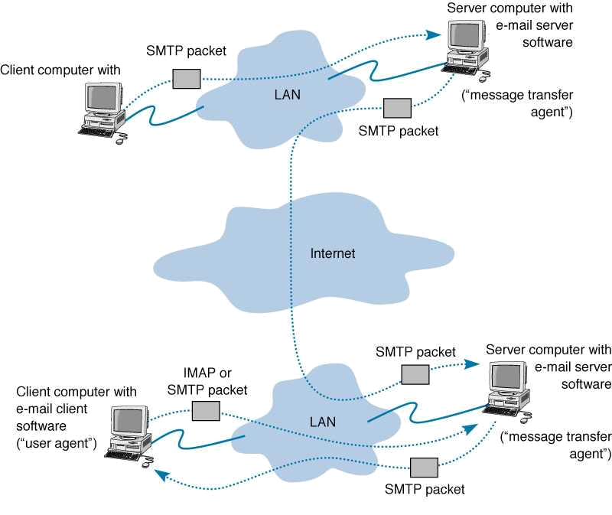
How SMTP Works
Server computer with
e-mail server software
Client computer
SMTP packet
(“message transfer agent”)
with e-mail client software
LAN
SMTP packet
reads the packet’s destination address and sends it over the Internet to the receiver’s mail server.
(“user agent”)
an e-mail message is sent as an SMTP packet to the local mail server
Internet
SMTP packet
Server computer with
IMAP or
POP packet
e-mail server software
Client computer
contacts the mail server which then downloads the message
LAN
stores the message in the receiver’s mail box
SMTP packet
Copyright 2005 John Wiley & Sons, Inc
1 - <number>

Slide 45
Host Based e-mail Architectures
An old method used on UNIX based hosts
Similar to client-server architecture, except
  Client PC replaced by a terminal (or emulator)
    Sends all keystrokes to the server
    Display characters received from the server
  All software reside on server
    Takes client keystrokes and understand user’s commands
    Creates SMTP packets and sends them to next mail server
Copyright 2005 John Wiley & Sons, Inc
1 - <number>

Slide 46
Three-Tier Client-Server Arch.
Best known example: Web based email (e.g., Hotmail)
Server computer with email server software
Client computer with Web Browser
Server computer with Web server software
sends HTTP requests to the Web server
sends HTTP responses to the Web client
translates the client’s HTTP requests into SMTP packets then send them to the Mail server
performs the same functions as the mail server in the two-tier example
No need for an email user agent
Copyright 2005 John Wiley & Sons, Inc
1 - <number>

Slide 47
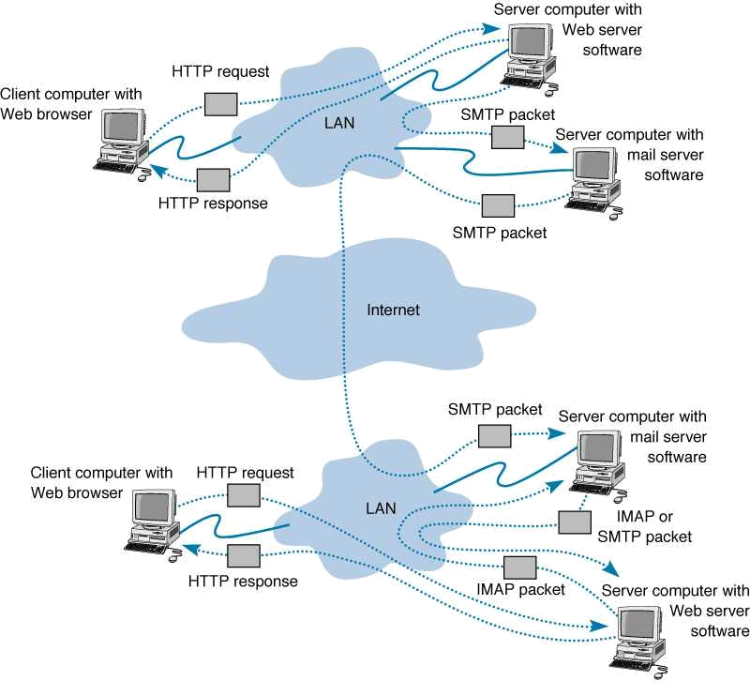
Web-based e-mail
Server computer with
HTTP request
Web server software
Client computer with
Web browser
LAN
SMTP packet
Server computer with
email server software
HTTP response
SMTP packet
Internet
SMTP packet
Server computer with
HTTP request
e-mail server software
Client computer with
Web browser
LAN
IMAP or
POP packet
HTTP response
IMAP packet
Server computer with
Web server software
Copyright 2005 John Wiley & Sons, Inc
1 - <number>

Slide 48
SMTP Message
Header
(source and destination addresses, date, subject,
and other information about the e-mail message)
Body
(message itself)
Attachments
(additional files included
along with the e-mail message)
Copyright 2005 John Wiley & Sons, Inc
1 - <number>

Slide 49
Sample SMTP Message
Text in “ “ are ignored
From: “Alan Dennis;”<adennis@indiana.edu>
TO: “Pat Someone” <someone@somewhere.com>
Date: Mon 06 Aug 2001 19:03:02 GMT
Subject: Sample Note
Message-Id: <4.1.20000623164823.009f5e80@IMAP.IU.EDU>
DATA:
This is an example of an e-mail message
Header
Body
Unique ID used to keep track of messages.
Note that this SMTP message has no attachments.
Copyright 2005 John Wiley & Sons, Inc
1 - <number>

Slide 50
MIME
Multipurpose Internet Mail Extension
  A graphics capable mail transfer agent protocol (to send graphical information in addition to text)
    SMPT designed for text transfer only
  Included as part of an e-mail client
  Translates graphical information into text allowing the graphic to be sent as part of an SMTP message (as a special attachment)
  Receiver’s e-mail client then translates the MIME attachment from text back into graphical format
Other Graphics capable mail agent protocols
  uuencode and binhex
Copyright 2005 John Wiley & Sons, Inc
1 - <number>

Slide 51
Listserv Discussion Groups
Mailing lists of users who join to discuss some special topic (e.g., cooking, typing, networking)
Some permit any member to post messages, some are more restricted
Parts of listserv
  Listserv Processor
    Process commands ( subscriptions, etc,)
  Listserv Mailer
    Receive a message and resend it to everyone
To subscribe
  Send an email to Listserv processor (address of the processor is different than the address of mailer)
Copyright 2005 John Wiley & Sons, Inc
1 - <number>

Slide 52
File Transfer Protocol (FTP)
Enables sending and receiving files over the Internet
Requires an application program on the client computer and a FTP server program on a server
Commonly used today for uploading web pages
Many packages available using FTP
  WS-FTP (a graphical FTP software)
FTP sites
  Closed sites
    Requires account name and password
  Anonymous sites
    Account name: anonymous; pwd: your email address
Copyright 2005 John Wiley & Sons, Inc
1 - <number>

Slide 53
Telnet
Allows one computer to log into other computers
  Remote login enabling full control of the host
Requires an application program on the client computer and a Telnet server program on a server
  Client program emulates a “dumb” terminal
Many packages available conforming Telnet
  EWAN
Requires account name and password
  Anonymous sites
    Account name: anonymous; pwd: your email address
Copyright 2005 John Wiley & Sons, Inc
1 - <number>

Slide 54
Instant Messaging (IM)
A client-server program that allows real-time typed messages to be exchanged
  Client needs an IM client software
  Server needs an IM server package
Some types allow voice and video packets to be sent
  Like a telephone
Examples include AOL and ICQ
Two step process:
  Telling IM server that you are online
  Chatting
Copyright 2005 John Wiley & Sons, Inc
1 - <number>

Slide 55
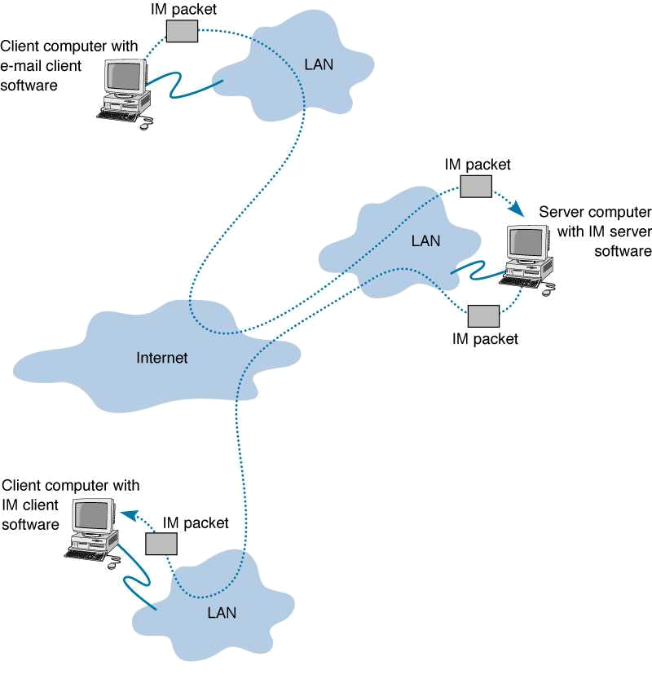
How Instant Messaging Works
Client computer with
When you type some text, your IM client sends the text in a packet to the IM server which relays it to your friend.
IM packet
e-mail client software
LAN
IM packet
Server computer with
sends a request to the IM server telling it that you are online. If a friend connects, the IM server sends a packet to your IM client and vice versa
LAN
with IM server software
Internet
IM packet
Client computer with
If a chat session has more than two clients, multiple packets are sent by the IM server. IM servers can also relay information to other IM servers.
IM client software
IM packet
LAN
Copyright 2005 John Wiley & Sons, Inc
1 - <number>

Slide 56
Videoconferencing
Provides real time transmission of video and audio signals among two or more locations
  Allows people to meet at the same time in different locations
  Saving money and time by not having to move people around (conference calling does the same thing)
Typically involves 2 special purpose rooms with cameras and displays
Desktop videoconferencing
  Low cost application linking small video cameras and microphones together over the Internet
  No need for special rooms
  Example: Net Meeting sw on clients communicating through a videoconference server
Copyright 2005 John Wiley & Sons, Inc
1 - <number>

Slide 57
Videoconferencing Standards
Proprietary early systems
Common standards in use today
  H.320
    Designed for room-to-room videoconferencing over high-speed phone lines
  H.323
    Family of standards designed for desktop videoconferencing and just simple audio conferencing over Internet
  MPEG-2
    Designed for faster connections such as LAN or privately owned WANs
Copyright 2005 John Wiley & Sons, Inc
1 - <number>

Slide 58
Webcasting
Special type of one-directional videoconferencing
  Content is sent from the server to users
Process
  Content created by developer
  Downloaded as needed by the user
  Played by a plug-in to a Web browser
No standards for webcasting yet
  Defacto standards: products by RealNetworks
Copyright 2005 John Wiley & Sons, Inc
1 - <number>

